Slide 1
INFO 102 Role Model
By drew scott

Slide 2
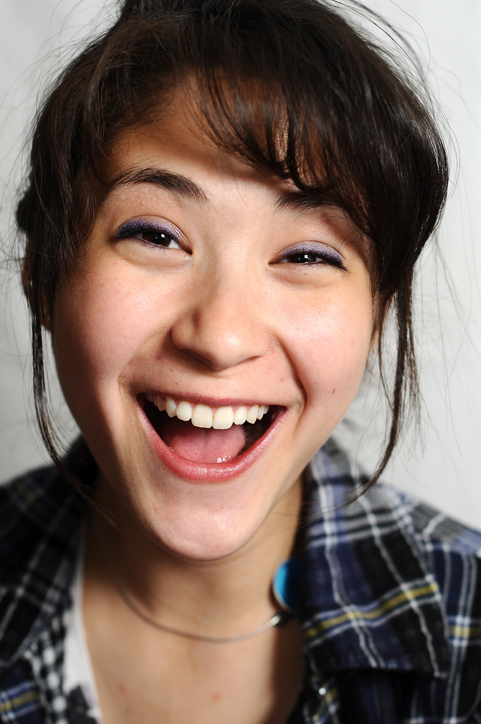
So who’s the role model?
I decided to interview somebody close to home, a fellow Husky, Zorah Fung!
Zorah is a CSE lecturer at UW, currently she teaches the intro to programming series (142 and 143).
Zorah earned a B.S. in CSE and a masters right here at UW! Wooooow!
When she isn’t teaching, Zorah works at a StartUp in the Bay Area called Sift Science.
Zorah actively promotes women in tech!

Slide 3
About me
I plan to major in Electrical Engineering (hopefully at UW!)
I’m taking Informatics 102 because on top of being interesting it also covers a diversity credit, but I’m really appreciating the content of the class, especially all the guest speakers we have!
Currently I am taking CSE 143 with Zorah Fung, she’s a great lecturer and I’d definitely recommend her to anyone looking to take the CSE 14X series!

Slide 4
So why is Zorah so impressive?
One of the largest reasons Zorah is impressive is because she teaches many of the future minds of the tech industry, specifically right as many people (specifically lots of women) are finding out if the tech industry is something they would be interested in!
She also has “been heavily involved in K-12 outreach programs” that help younger students learn about how great the tech industry can be! (https://www.cs.washington.edu/people/faculty/zorahf)
She’s a great role model, especially for women, because of her enthusiasm for tech and making sure it’s diversified!

Slide 5
Traits that should be adopted
One of Zorah’s leading traits is her pure enthusiasm for computer science, and this willingness to learn and natural curiosity could, and should, be applied to any tech-related field!
Willingness to diversify. On top of backing different programs to get women in tech, Zorah always encourages many different people to get involved in tech, which is a good thing to do because it helps increase progress!
Teach-ability. Zorah not only knows how to make her tech work, she can teach others how to use/make their own tech well.

Slide 6
Closing Remarks
Thanks for your time, I hope you enjoyed the presentation!
Interesting stuff to know: If you ever want to talk to Zorah, she teaches here so you can find and talk to her in person! She has office hours throughout the week and I’m sure she wouldn’t mind answering any tech-related questions.

